Slide 1

Cocktail Recommendation System

Slide 2
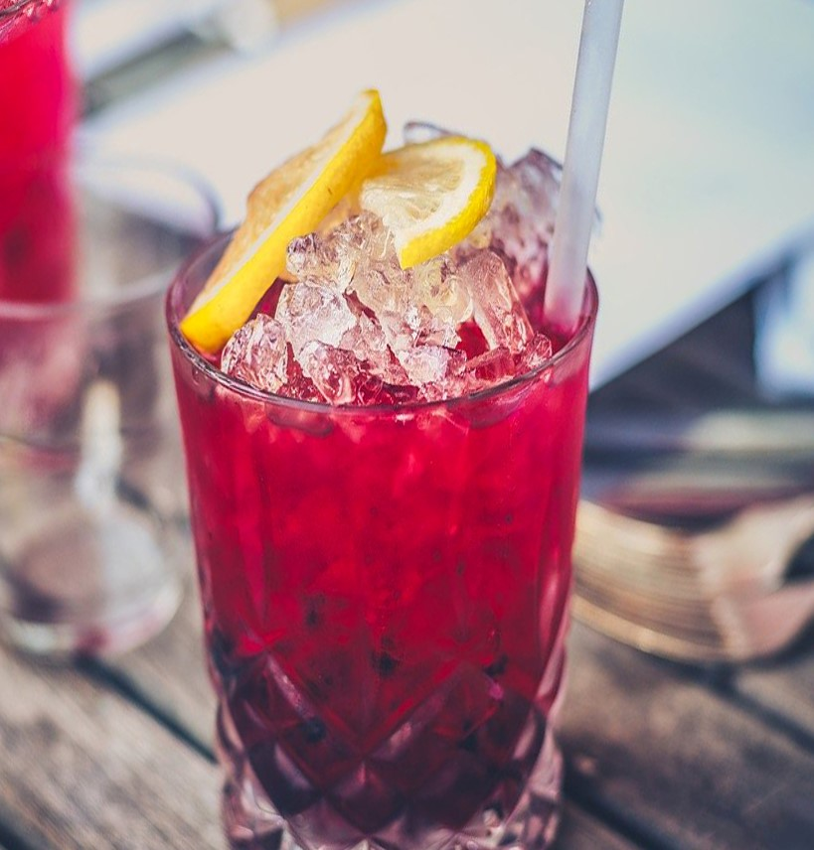
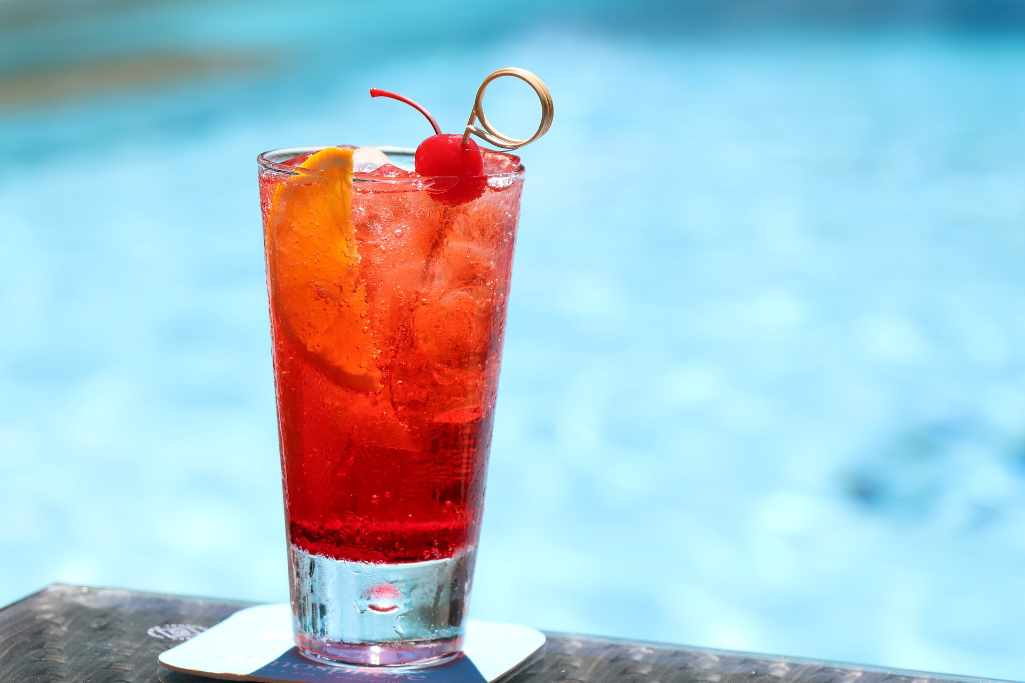
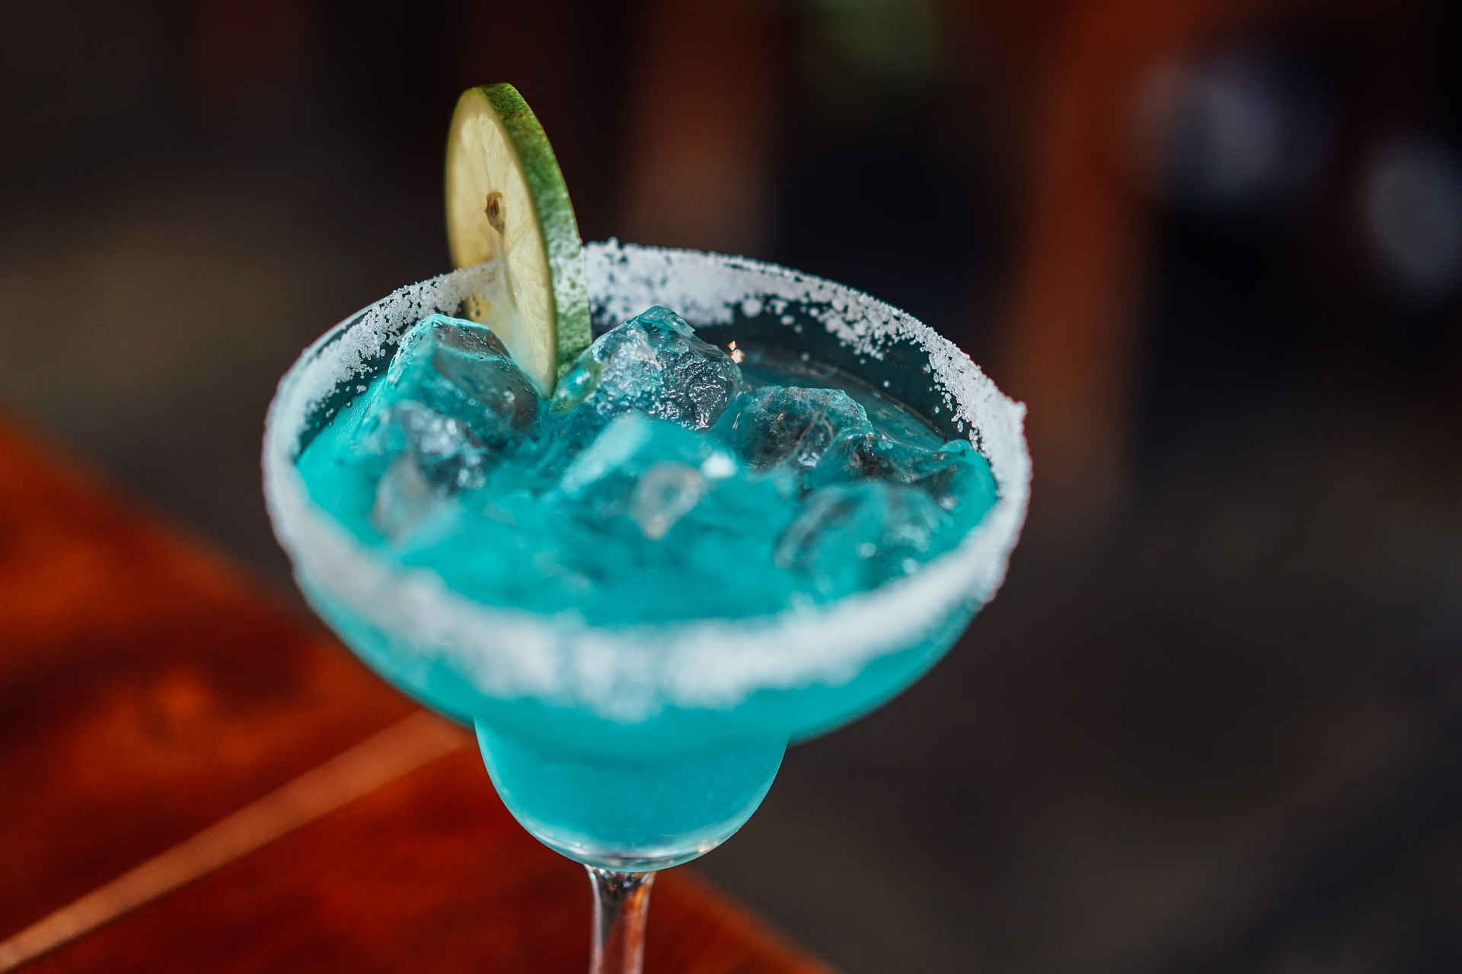
We have an option for you!
When you go to the bar always order the same drink?

Slide 3
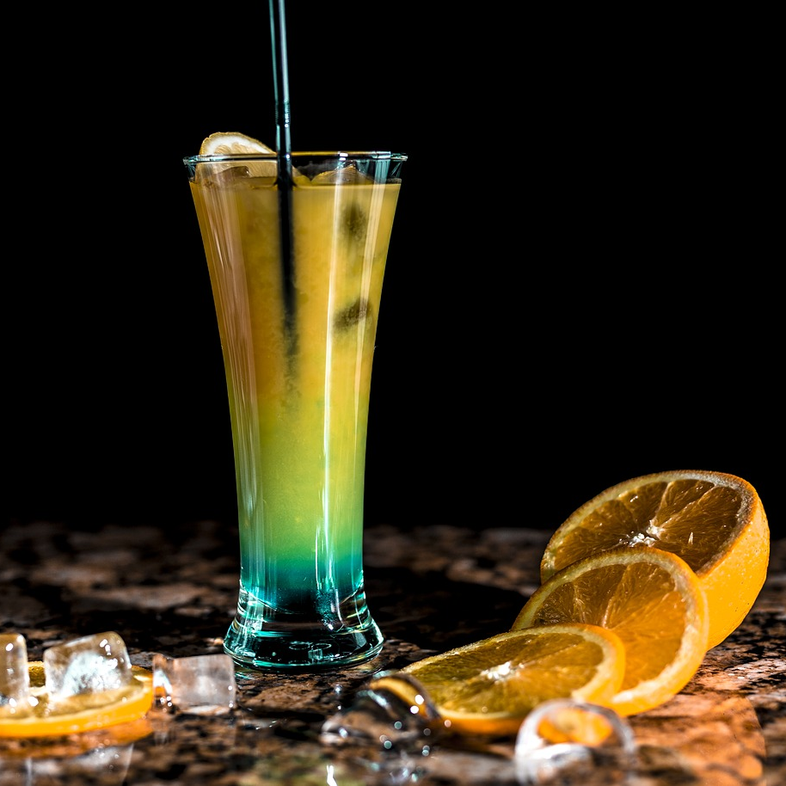
Business Problem
To build a recommendation system based on drink and cocktail recipes from around the world.

Slide 4
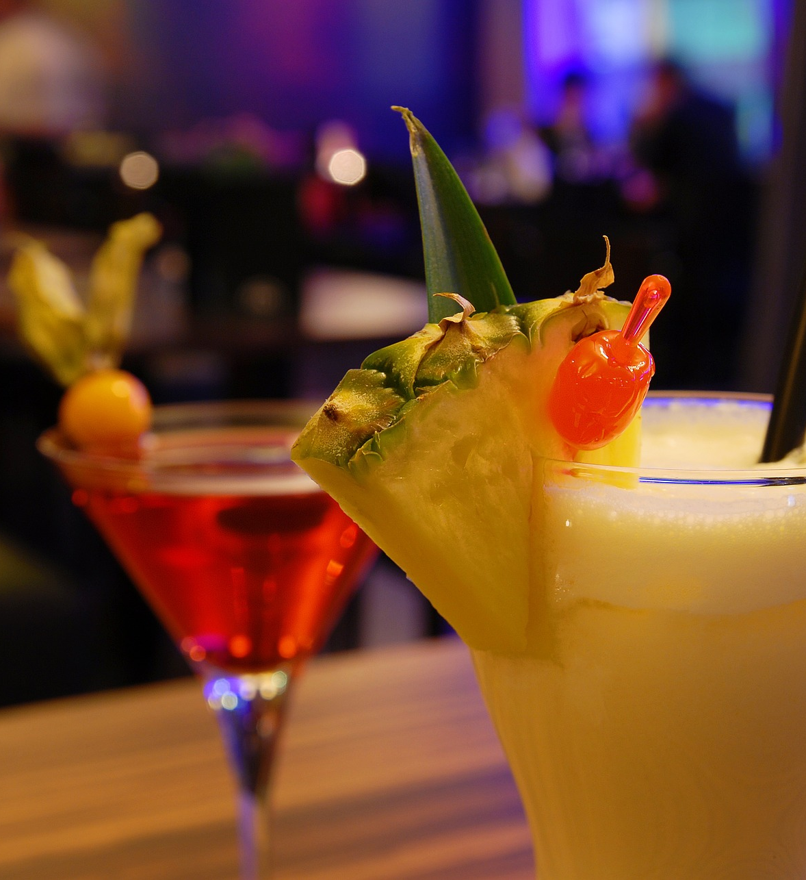
Machine Learning Problem
ONE OF THE CENTRAL AREAS OF RESEARCH IN ML
Recommendation systems are a very well studied area of Machine Learning, generally relying on unsupervised learning techniques or reinforcement learning
CLUSTERING RECOMMENDATION IS WELL STUDIED
For our specific problem, we implement two different clustering models to generate the predictions: K-Means and Mean-Shift

Slide 5
Machine Learning Components
01
01
Ingredients
List
Ingredients
List
[0,1,1,…,0,0,1]
02
[0,1,1,…,0,0,1]
02
05
05
Kernel PCA
Kernel PCA
Final
output:
Cluster 2
2 Principal
Components
Final
output:
Cluster 5
6 Principal
Components
2-dimensionalvector
6-dimensionalvector
Mean Shift
clustering
[-1.45,2.3]
K-means
clustering
[-1.45,…,2.3]
3 clusters
Output PCA
6 clusters
Output PCA
04
04
03
03
Mean Shift clustering
K-means
clustering

Slide 6
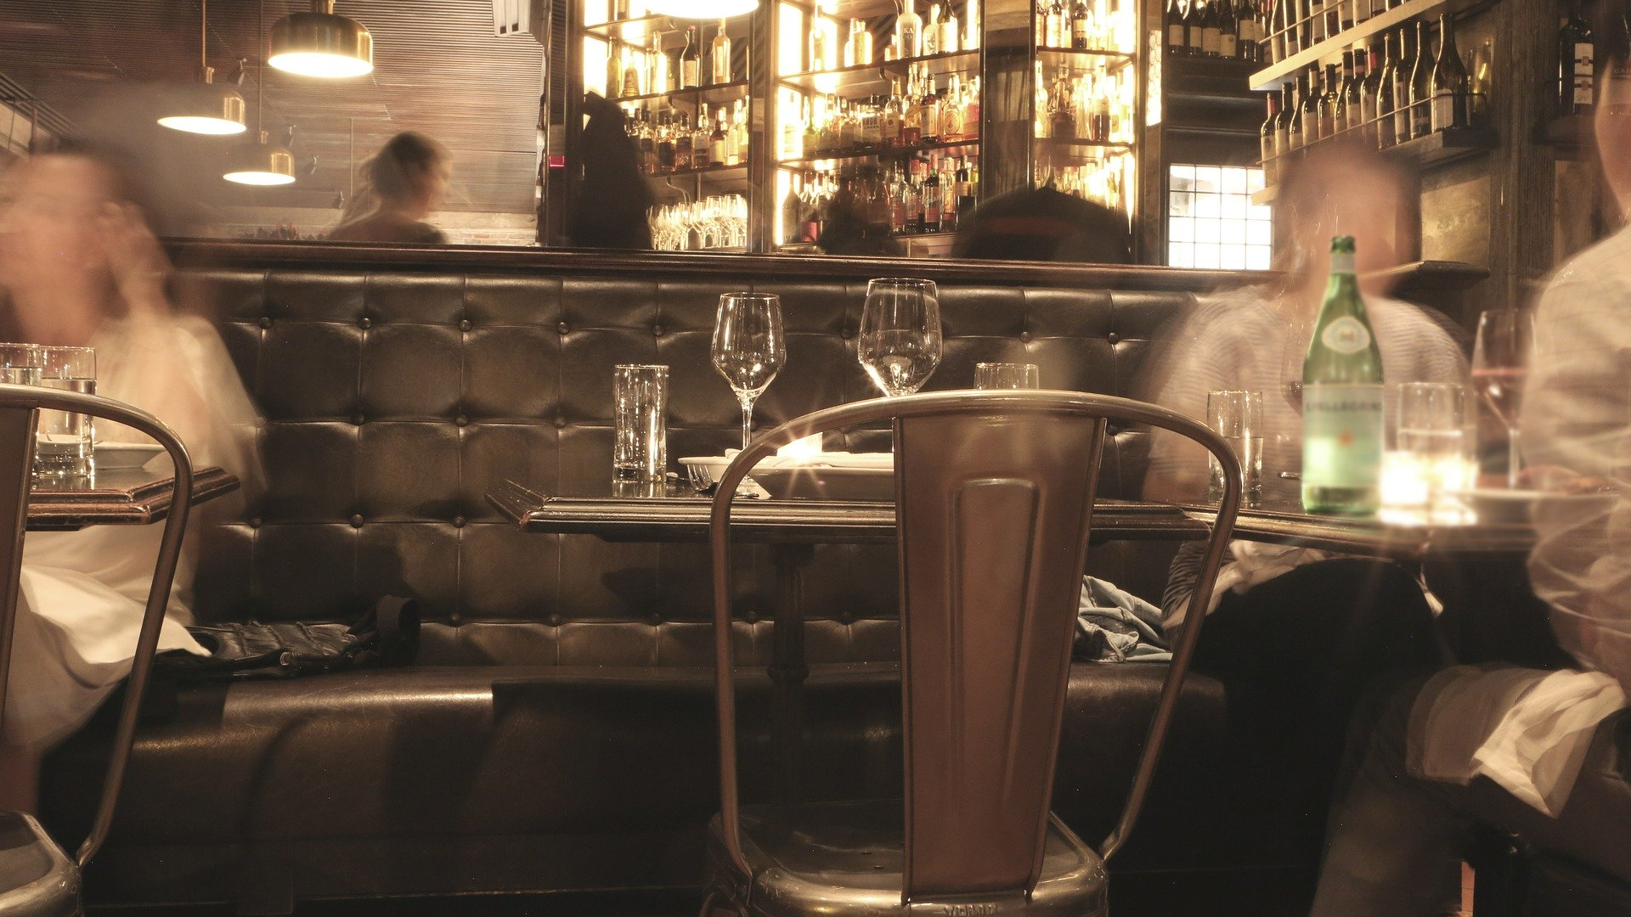



Data Ingestion and Feature
Engineering
DATA SOURCES
We call TheCocktailDB API, the output is a JSON object with the information that we requested.
CLOUD STORAGE
We access the extracted data in Big Query, where we build a table that stores the info.
DATA PROCESSING
After our initial data load, we manipulate and transform the data in SQL as a follow p step to be able to use it.
The first thing we do is that we turn the cocktails into an occurrence matrix for ingredients, 0 if it does not occur in the cocktail, 1 if it does.

Slide 7
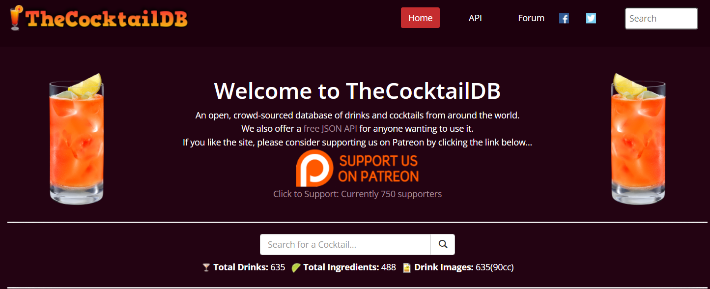
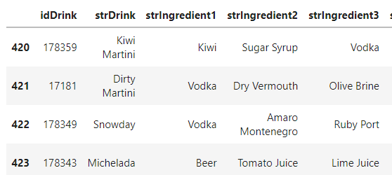
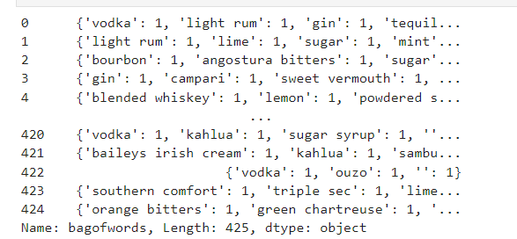
Data Ingestion and Feature Engineering
www.thecocktaildb.com/api/json/v1/1/search.php?f=a
drink_jaison["strInstructionsZH_HANS"] = drink_jaison["strInstructionsZH-HANS"]
del drink_jaison["strInstructionsZH-HANS"]
path = f"cocktails/{letter[0]}/ingredients.json"
{"idDrink": "11000", "strDrink": "Mojito", "strDrinkAlternate": null, "strTags": "IBA,ContemporaryClassic,Alcoholic,USA,Asia,Vegan,Citrus,Brunch,Hangover,Mild",
"strVideo": null, "strCategory": "Cocktail", "strIBA": "Contemporary Classics", "strAlcoholic": "Alcoholic", "strGlass": "Highball glass", "strInstructions":
"Muddle mint leaves with sugar and lime juice. Add a splash of soda water and fill the glass with cracked ice. Pour the rum and top with soda water. Garnish and serve with straw.", "strInstructionsES":
null, "strInstructionsDE": "Minzbl\u00e4tter mit Zucker und Limettensaft verr\u00fchren. F\u00fcge einen Spritzer Sodawasser hinzu und f\u00fclle das Glas mit gebrochenem Eis.
Den Rum eingie\u00dfen und mit Sodawasser \u00fcbergie\u00dfen. Garnieren und mit einem Strohhalm servieren.", "strInstructionsFR": null, "strInstructionsIT":
"Pestare le foglie di menta con lo zucchero e il succo di lime.\r\nAggiungere una spruzzata di acqua di seltz e riempi il bicchiere con ghiaccio tritato.\r\nVersare il rum e riempire
con acqua di seltz.\r\nGuarnire con una fetta di lime, servire con una cannuccia.", ": null}
CREATE EXTERNAL TABLE IF NOT EXISTS `{{ params.project_id }}.cocktails_dataset.cocktail_dag`
OPTIONS ( uris = ['gs://{{ params.bucket }}/cocktails/*/ingredients.json’], format = 'NEWLINE_DELIMITED_JSON’ );
Transform letters to lowercase
One Hot Encoding

Slide 8



System Design
Online
Prediction
1
2
3
4
5
Data Collection
Data Storage
Feature
Extraction
Model
Deploymet
Online
Precdiction
COCKTAILDB API
Data
Collection
Data
Storage
Feature
Extraction
Data
Storage
Model
Generation
Batch
Storage
Batch
Prediction
5
1
2
3
4
Batch
Predictions
6

Slide 9
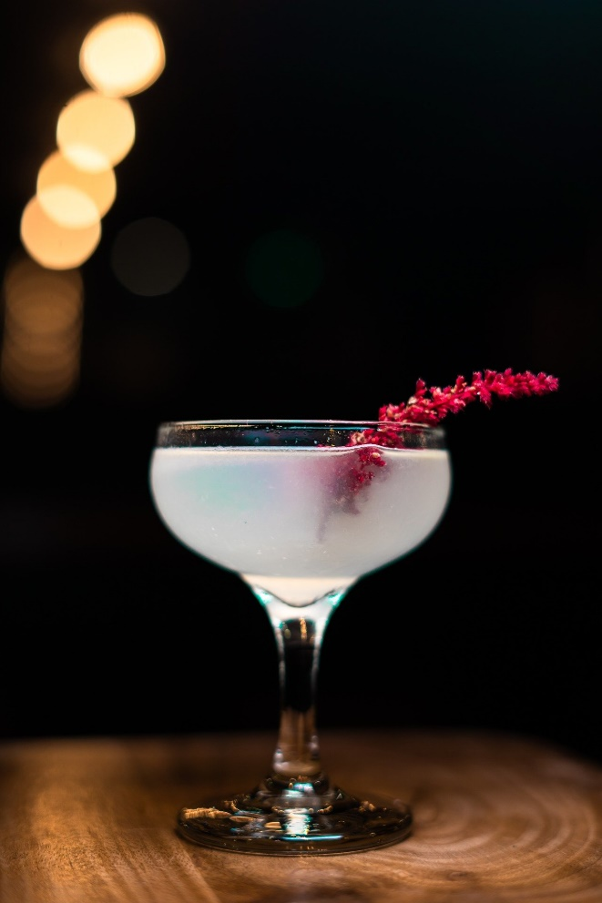
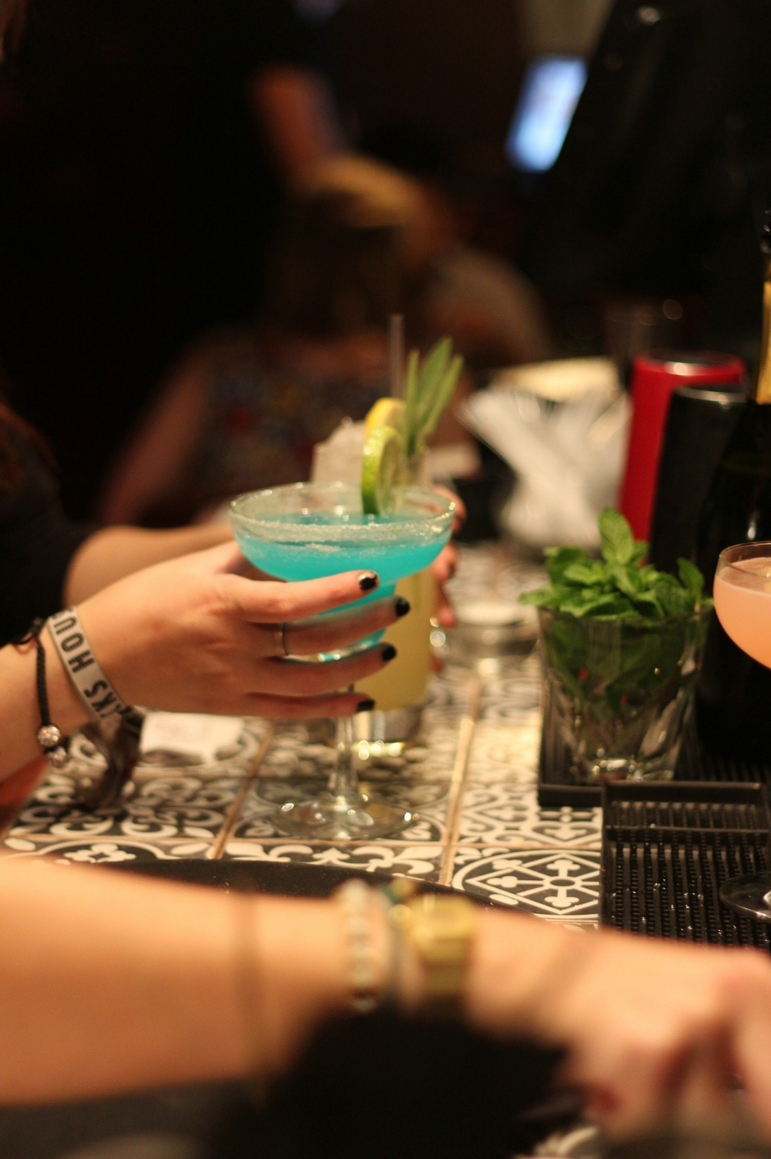
Reflections
What would you do different?
What were some challenges?
What would you do next?

Slide 10
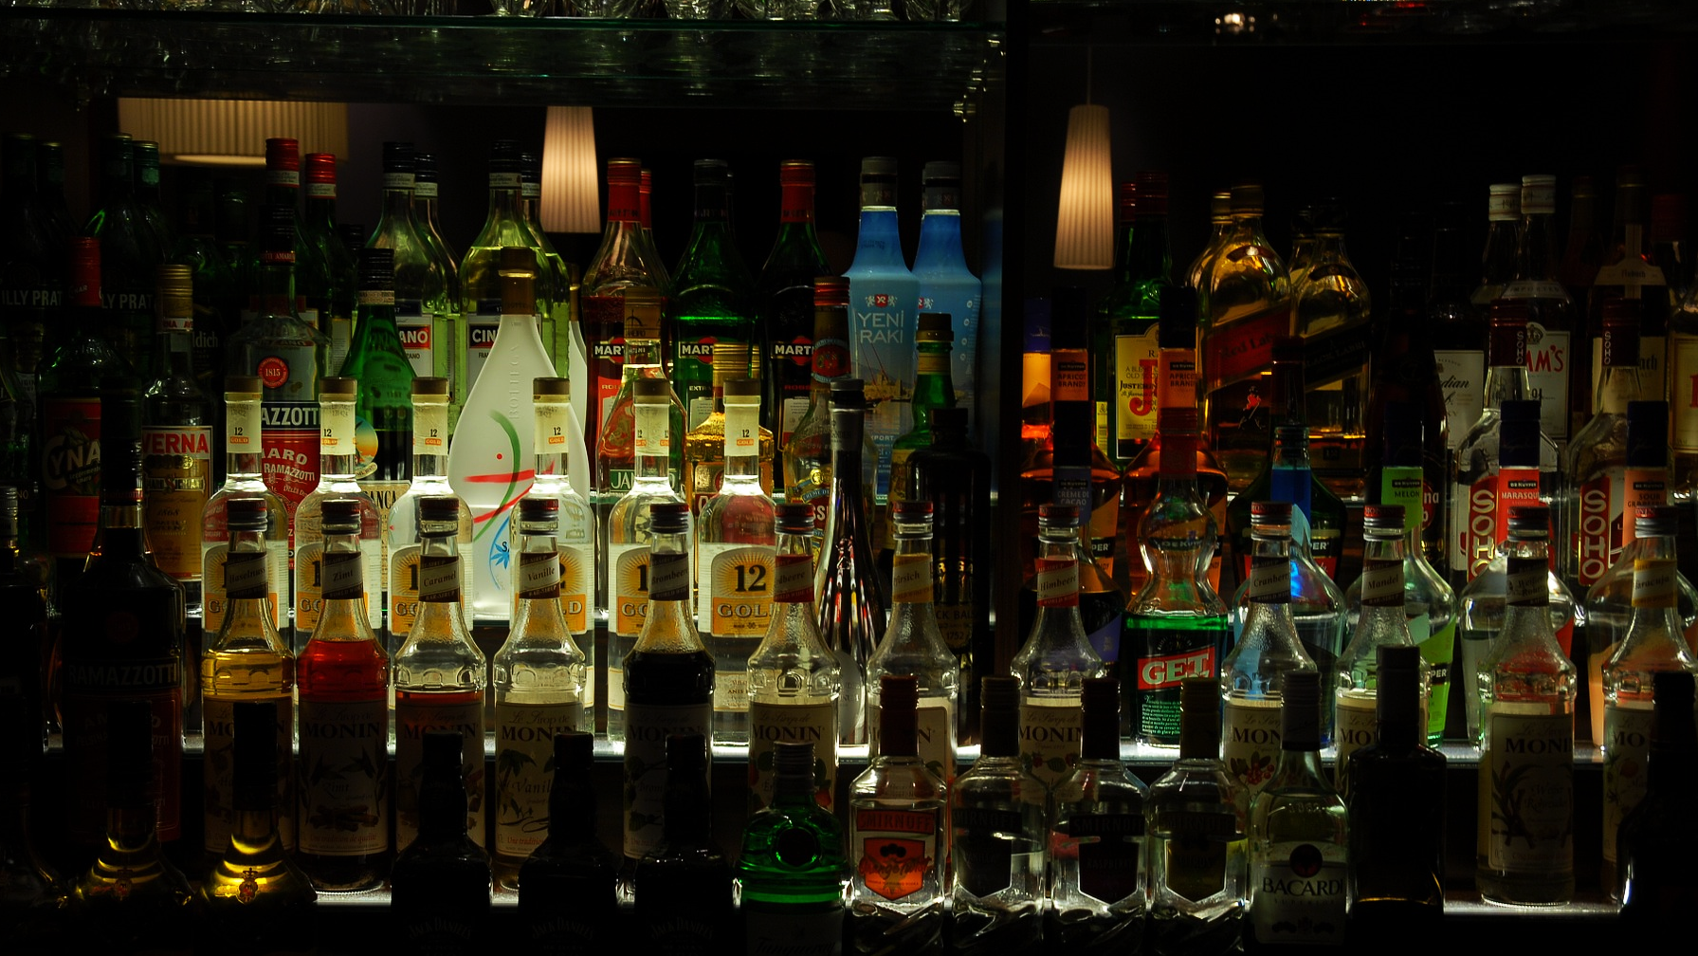
thank you

